Slide 1
CAMSS30
U.S. Air Force
Medium Shelter System
NSN National Stock Number
Green: 5419-01-465-3023
NSN National Stock Number
Tan: 5419-01-465-3019

Slide 2

CAMSS30 Shelter Informational Video

Slide 3
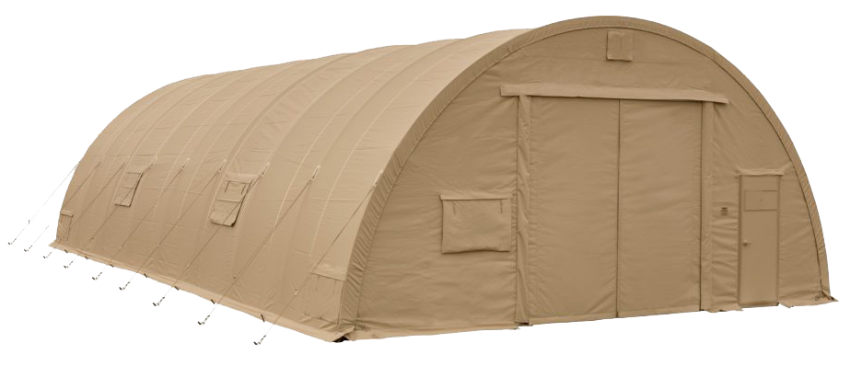
CAMSS30 Medium Small Shelter System
Official U.S. Air Force Medium Shelter
Large vehicle entries for maintenance and many others
Versatile in extreme environments
Over 2,500 shelters deployed
From the extreme heat of the Middle East to the freezing temps of Alaska
Proven in extensive U.S. government lab tests and in the field
For more information on our CAMSS30, click
www.camss.com/product/camss30-medium-shelter-system

Slide 4

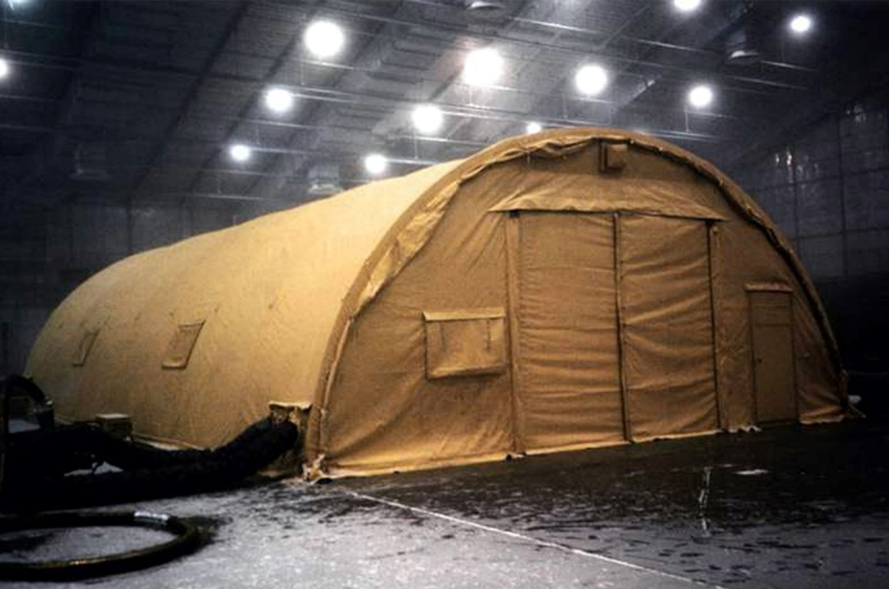
CAMSS30 Extreme Testing
29’6” W x 52’ L x 14’9” H
1534 sq. ft. usable space
Lightweight and durable
Sets up in four (4) hours with a trained crew of six (6)
Easily transportable on a 463L pallet
Assembles without heavy equipment
Used for maintenance, flight line support, command posts, dining, recreation, billeting, and forward operating bases
Fire resistant per NFPA 701

Slide 5
CAMSS30 Extreme Testing
Tested from -50° to 125° F to maintain inside temperatures of 40° to 80° F with standard military 5-ton ECUs. High heat test conducted with full simulated Saudi Arabia solar load. (Source Selection Testing – McKinley Climatic Laboratories)
Wind load capability testing (Source Selection Testing – Aberdeen Proving Ground)
Snow load capability of 20 psf (Source Selection Review)
Meets naked eye blackout test (Source Selection Testing)
20 setup/strikes and still mission capable (AFOTEC Testing)
Assembles in under two and one half hours (150 minutes) with trained crew of six (AFOTEC Testing)
Tested and passed rain test 40 mph wind with rate of 5 inches per hour (Source Selection Testing – Aberdeen Proving Ground)
Tested to assemble in MOPP-2 and cold weather gear (AFOTEC Testing)

Slide 6

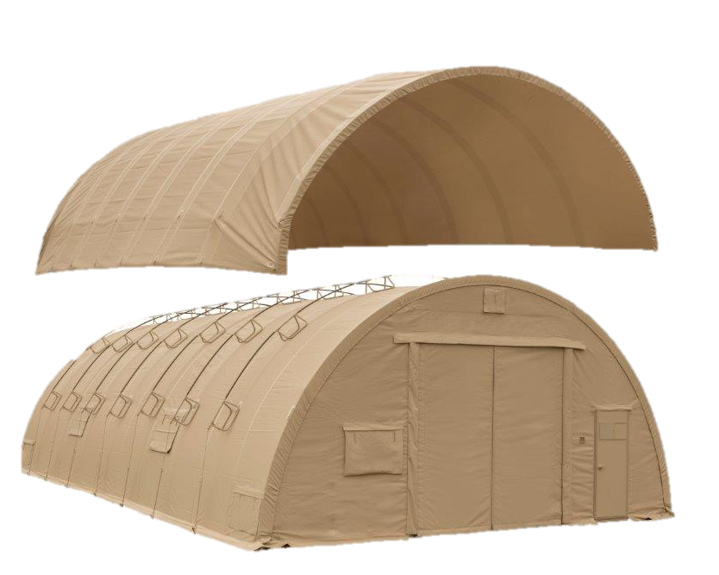
OPTIONAL: CAMSS30 SolarFly
Significantly reduces heat from sun
Lightweight and compact
Eighteen (18) Fly ropes and eighteen (18) guys anchors
Fly, stands, rods, ropes and spikes weigh 470 lbs.
Designed to install without any disassembly of the shelter
RF welded mil-spec fabric with mesh that meets fire rating ASTM D6413
Withstands 55 mph sustained winds with 65 mph wind gusts
Part Numbers
Tan Color – CAMSS-30Q-SF-T
Green Color – CAMSS-30Q-SF-G
NSN National Stock Number
8340-01-653-5482

Slide 7

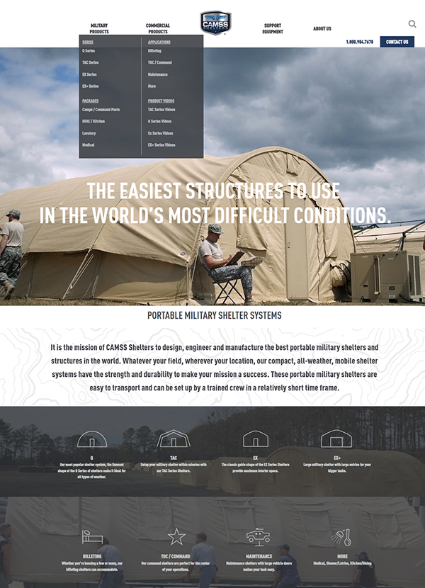
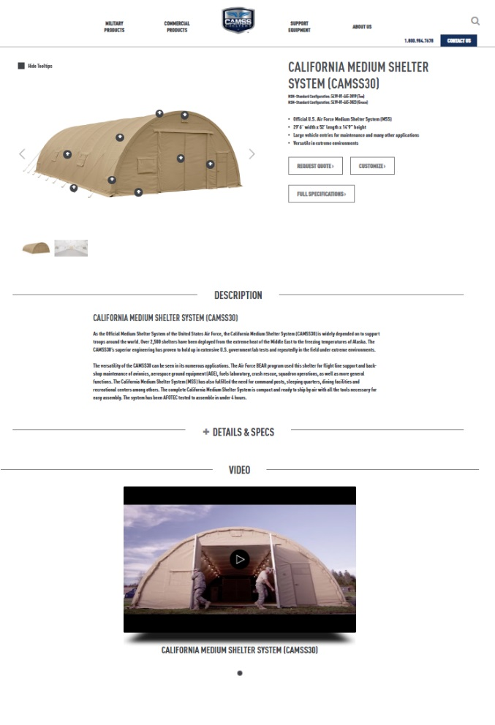
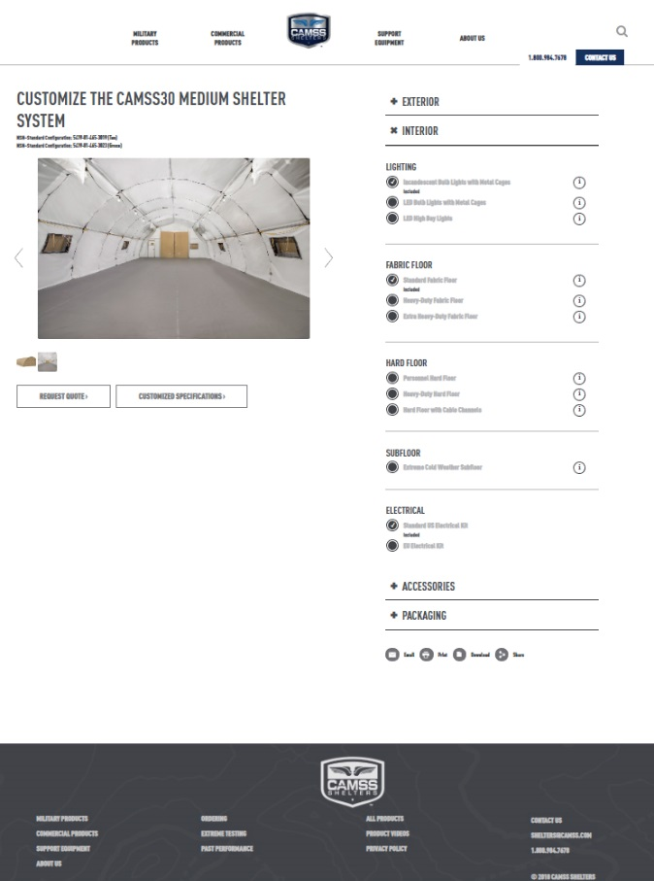
CAMSS Website
CAMSS.com
Product Page
Customize

Slide 8
Thank you for considering CAMSS Shelters
For further questions, please contact us below

